Slide 1
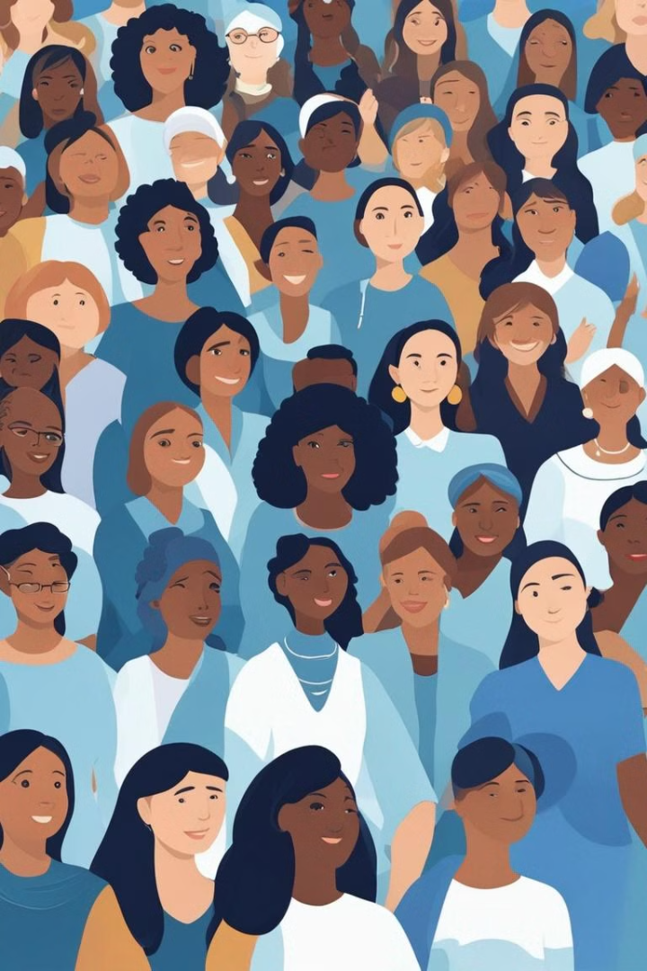

Introduction to International Women's Day
International Women's Day is a global day celebrating the social, economic, cultural, and political achievements of women. It is a time to reflect on progress made, to call for change, and to celebrate acts of courage and determination.
Ra
by Rinku Yadav Rinku

Slide 2
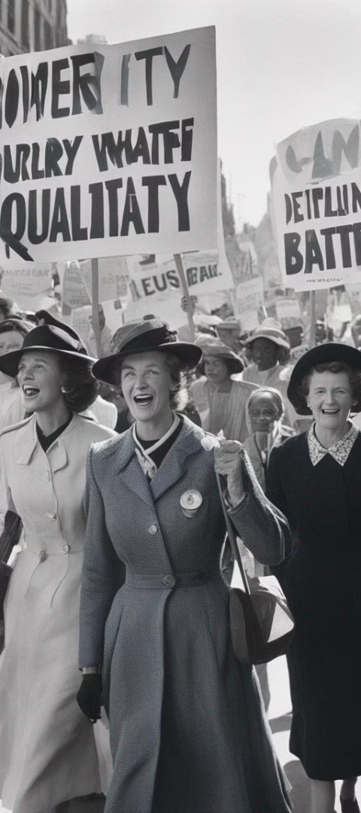
History and Significance of International Women's Day
1
Origin
International Women's Day has been observed since the early 1900s, a time of great expansion and turbulence in the industrialized world.
2
Official Recognition
It became an internationally recognized event after women gained suffrage and rights in the early 20th century.
3
Importance
It is a focal point in women's rights movements globally and is often used as an opportunity to celebrate the achievements of women.

Slide 3

Achievements and Progress Made by Women Globally
Leadership Roles
Education and Innovation
Social Activism
Women have made strides in leadership positions across various industries and sectors, breaking barriers and inspiring future generations.
Women have been at the forefront of social and political activism, driving positive change and advocating for justice.
Women have made significant contributions to education and innovation, empowering communities and advancing society.

Slide 4
Challenges and Barriers Faced by Women
Gender Discrimination
Violence and Inequality
Underrepresentation
Many women still face discrimination and bias in the workplace and other social environments.
Women are often underrepresented in decision-making processes, limiting their influence and impact.
Women continue to experience various forms of violence and unequal treatment, hindering their progress.

Slide 5

Empowering Women Through Education and Economic Opportunities
1
Education Access
2
Entrepreneurship
3
Skills Development
Providing equal access to education for women and girls is crucial for empowerment and progress.
Supporting women entrepreneurs and businesses is essential for economic growth and diversity.
Investing in skill-building programs enhances women's capabilities and opens up job opportunities.

Slide 6



Promoting Gender Equality and Women's Rights
Equality
Empowerment
Human Rights
Advocating for equal rights and opportunities for all genders is essential for a fair and just society.
Empowering women to make their own choices and lead fulfilling lives is a fundamental aspect of gender equality.
Ensuring the protection and recognition of women's human rights is crucial for their well-being and development.

Slide 7
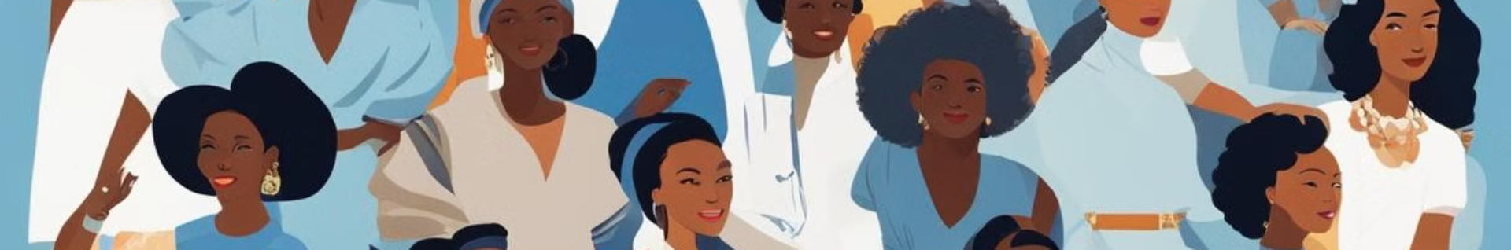



Celebrating the Achievements of Influential Women
Global Impact
Inspiration
Legacy
Recognizing and celebrating the global impact of influential women in various fields and endeavors.
Sharing stories of influential women to inspire and motivate individuals to pursue their passions and dreams.
Highlighting the lasting legacies of influential women in history and contemporary society.

Slide 8
Call to Action: How We Can All Contribute to Gender Equality
1K
50
100
Educational Initiatives
Vocational Training
Advocacy Networks
Supporting educational initiatives to ensure equal opportunities for learning and growth.
Providing vocational training to empower women to gain access to diverse career paths.
Joining advocacy networks to raise awareness and promote gender equality in communities.

